Slide 1


Slide 2


Modern Web Applications with SAFE Stack
Isaac Abraham

Slide 3
Who Am I?
Isaac Abraham
C# Developer since .NET 1.0
F# Developer for ~5 years
Founder of Compositional IT
F# consultancy, training, development
Yes, it’s possible (and advisable!) to build a business using F# ☺
Working on SAFE Stack since 2018

Slide 4

What is SAFE Stack?
The best way to write functional-first web applications

Slide 5
Demo
A real SAFE Stack application

Slide 6
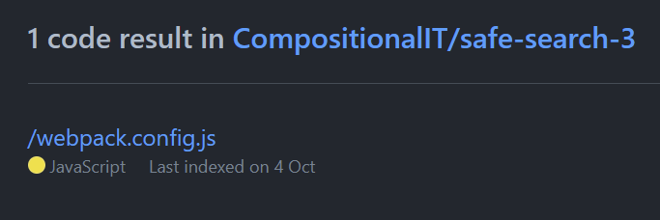
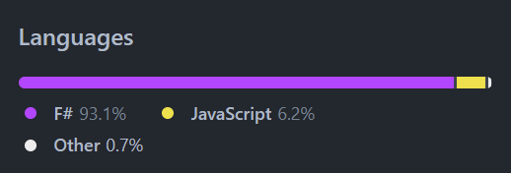
How much of that was F#?

Slide 7
OK, but what is SAFE Stack really?
S
F
E
Saturn
Server-side web
A
Azure
Cloud hosting & platform services
Fable
Client-side web
Elmish
UI Web Programming model

Slide 8
Why SAFE Stack?
Productive
F#, not JavaScript, in the browser
Easily share types + functions between client and server
Fun
Rewarding and enjoyable development cycle
Flexible
Not a walled garden
Use any JS library
Use any NuGet package
A safe bet
Mature platforms
Commercial support
Lots of tooling

Slide 9
Tell me more
Takes two popular and mature platforms
ASP .NET Core
Ties them together with F#
Simple
Robust + Typesafe
Performant
JavaScript and React

Slide 10
Full stack F# - really?
F#
ASP .NET Core
.NET Core
Elmish
JS
Saturn + Giraffe
Fable

Slide 11
A single language for your application
F# Code (Types, Functions etc.)
.NET Compiler
Fable
.NET
JavaScript

Slide 12
Demo
Creating your first SAFE Stack application

Slide 13
It’s not vapourware or magic
F# + .NET + JavaScript
No boundaries
No walled gardens – interop with any JS library
Robust, Succinct and Simple web programming
Productive, flexible and FUN!

Slide 14
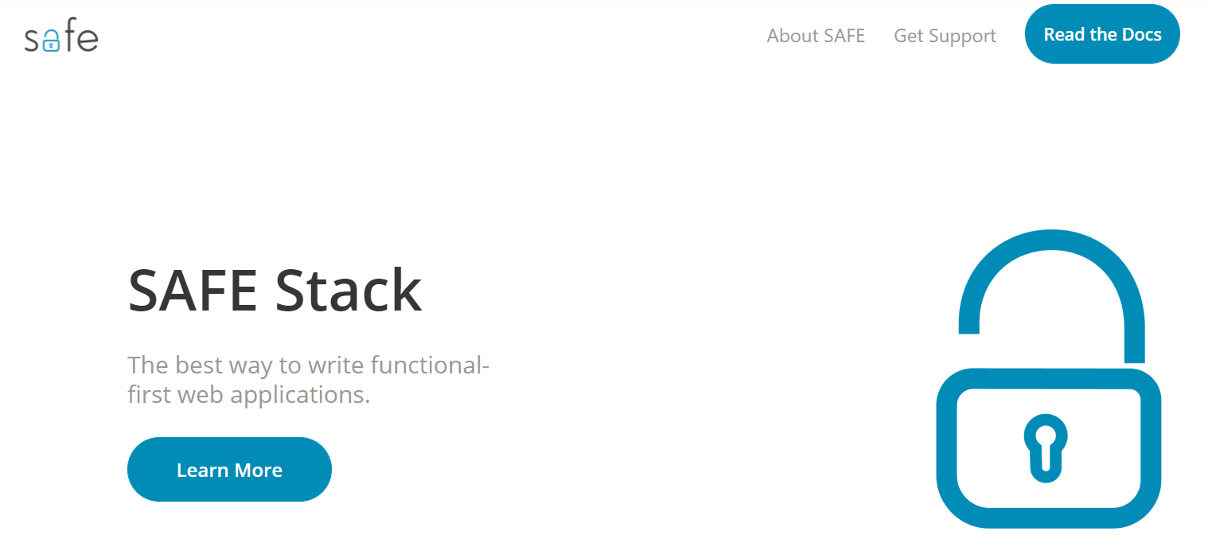
https://safe-stack.github.io/

Slide 15
Ask me anything!
Twitter @isaac_abraham
Email isaac@compositional-it.com
Web https://www.compositional-it.com

